Slide 1
ISE 503-DATA MANAGEMENT
JOB SEARCH SYSTEM

Slide 2
TEAM MEMBERS (ROLES AND RESPONSIBILITIES)
Sri Datta Y(115939828) - Database creation/insertion, Front-end, 4 queries
Moni Gayathri Sayana(115800067) - EER Model/UML, powerpoint, 3 queries
Saransh Surana(115997716)- Database design, powerpoint, 3 queries

Slide 3
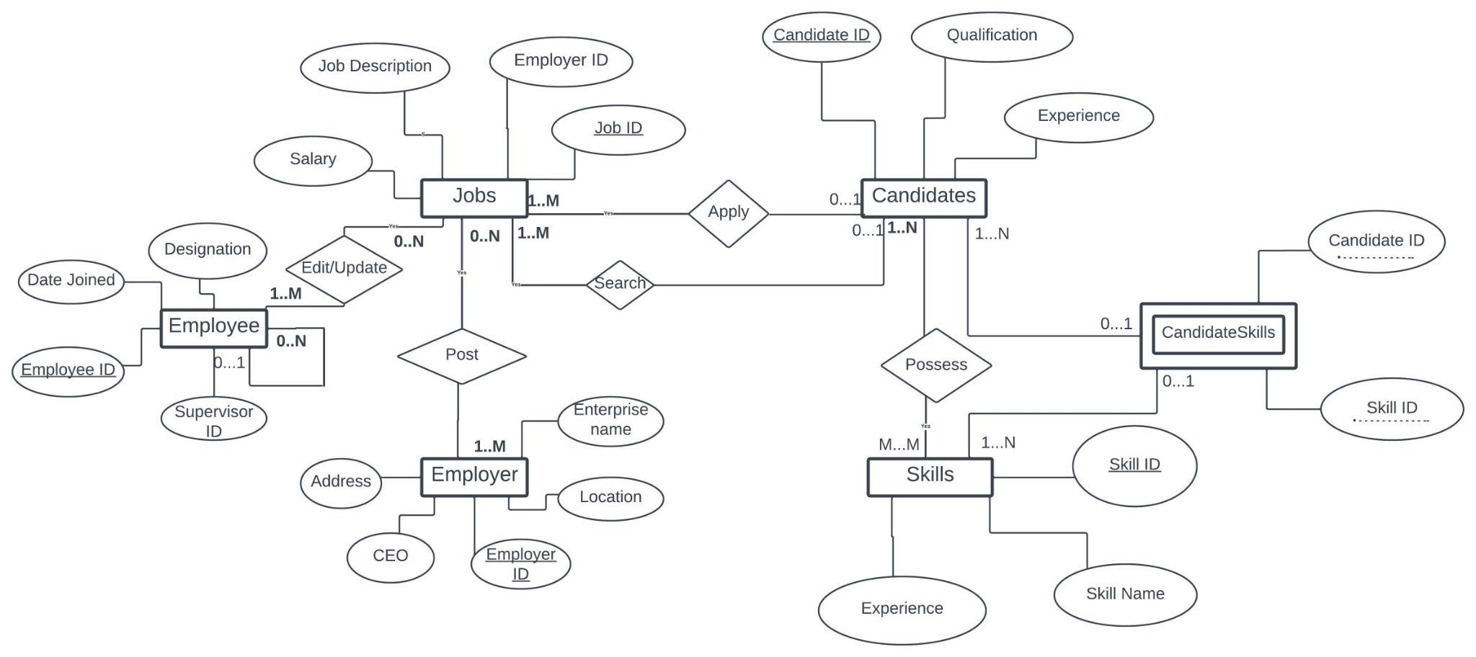
Enhanced Entity Relationship (EER) Diagram

Slide 4
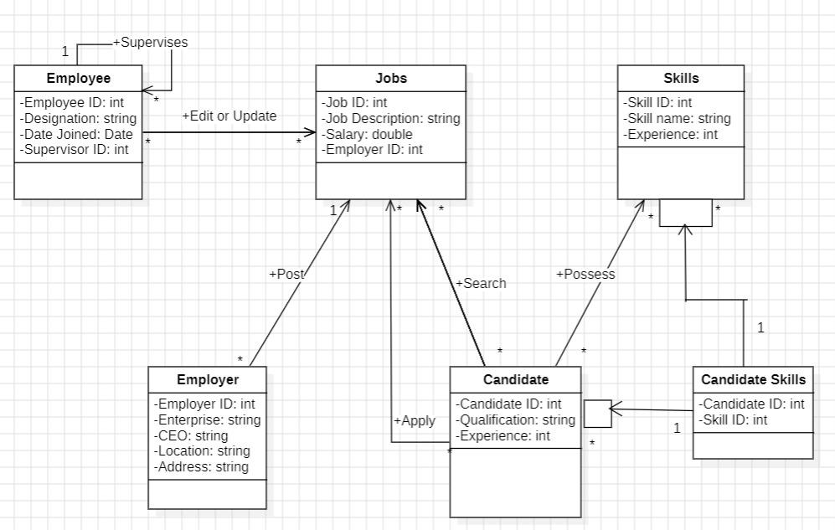
UML CLASS DIAGRAM

Slide 5
ENTITIES
EMPLOYEE
JOBS
EMPLOYER
CANDIDATES
SKILLS
CANDIDATESKILLS

Slide 6
ATTRIBUTES

Slide 7
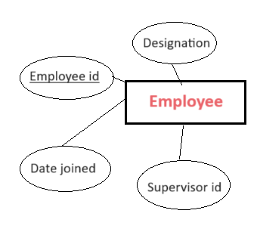
ATTRIBUTES FOR TABLE EMPLOYEE
Designation
Employee ID (Primary Key)
Date joined
Supervisor ID (FK to Employee)

Slide 8
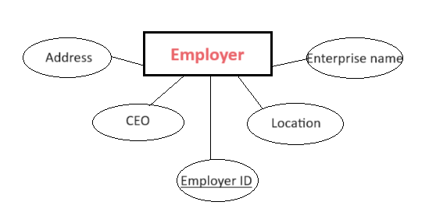
ATTRIBUTES FOR TABLE EMPLOYER
Address
CEO
Location
Enterprise name
Employer ID (Primary Key)

Slide 9
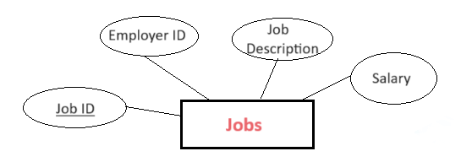
ATTRIBUTES FOR TABLE JOBS
Employer ID (FK to Employers)
Salary
Job ID (Primary Key)
Job Description

Slide 10
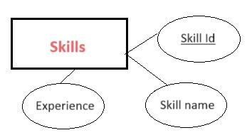
ATTRIBUTES FOR TABLE SKILLS
Skill ID (Primary Key)
Experience
Skill Name

Slide 11
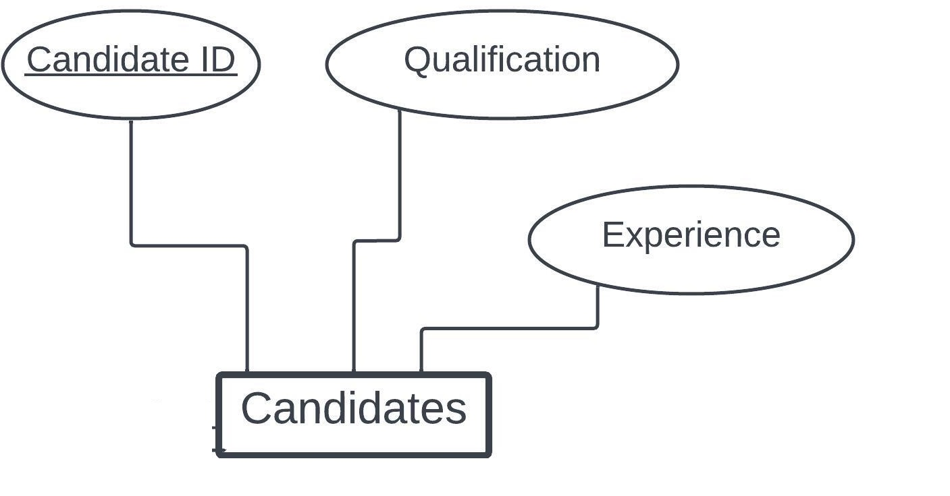
ATTRIBUTES FOR TABLE CANDIDATES
Qualification
Candidate ID (Primary Key)
Experience

Slide 12
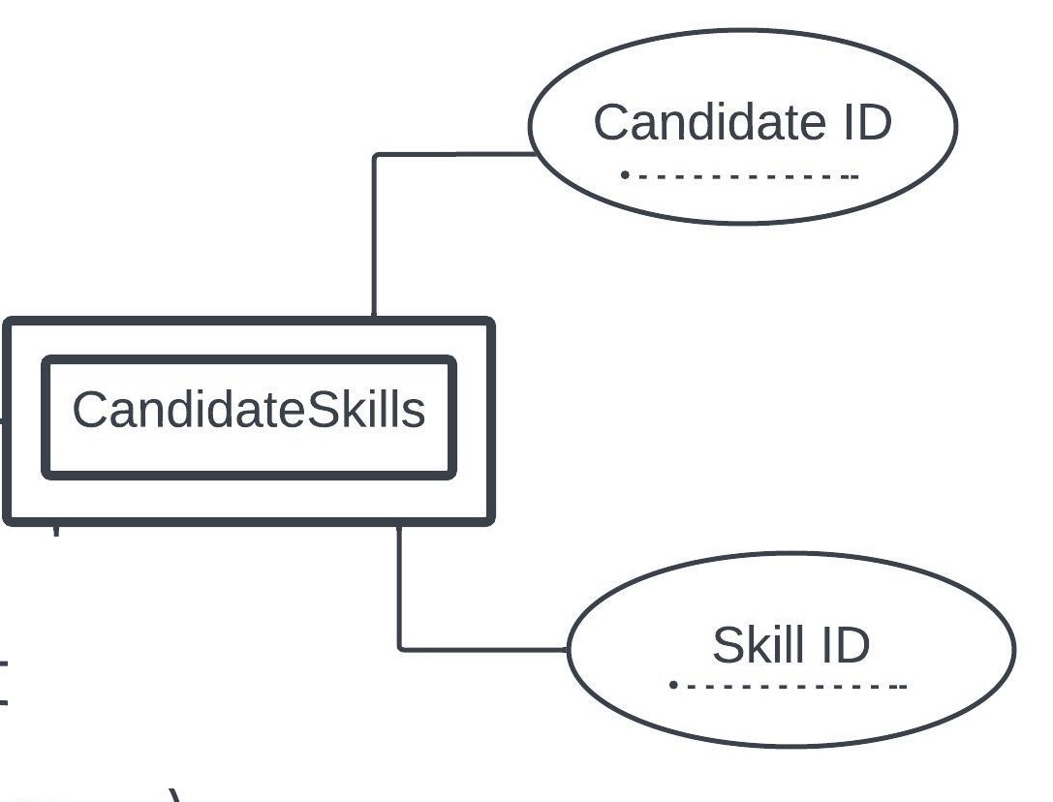
ATTRIBUTES FOR TABLE CANDIDATESKILLS
Candidate ID (FK to Candidates)
Skill ID (FK to Skills)
(Candidate ID + Skill ID is a Composite Primary Key)

Slide 13

CARDINALITIES
A candidate can apply for many jobs.
It is 1 to Many relationships.

Slide 14

CARDINALITIES
A employer can post many jobs.
It is many to many relationship

Slide 15

CARDINALITIES
S
A candidate can search for many jobs.
It is one to many relationships

Slide 16

CARDINALITIES
An employee can edit/update jobs.
It is Many to many relationships

Slide 17

CARDINALITIES
An employee can supervise many employees.
It is a one to many relationship

Slide 18

CARDINALITIES
A candidate can possess many skills
It is a Many to many relationship

Slide 19

CARDINALITIES
CandidateSkills has a 1 to many relationship

Slide 20

CARDINALITIES
CandidateSkills has a 1 to many relationship with Candidate

Slide 21
QUERIES

Slide 22
QUERY 1
Q1 . List all job descriptions and their corresponding salaries for jobs in 'New York' offered by employers with names starting with 'Global'.
Query : SELECT j.JobDescription, j.Salary
FROM Jobs j
JOIN Employers e ON j.EmployerID = e.EmployerID
WHERE e.Location = 'New York' AND e.EnterpriseName LIKE 'Global%';

Slide 23
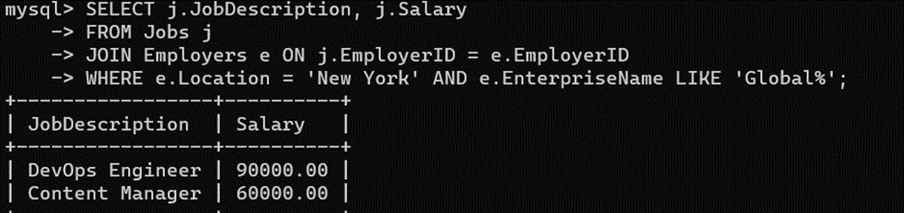
QUERY 1 OUTPUT

Slide 24
QUERY 2
Q2. Which candidates have qualifications in 'Computer Science' and skills in both 'Java Programming' and 'Database Management'?
Query : SELECT c.CandidateID, c.Qualification
FROM Candidates c
JOIN CandidateSkills cs ON c.CandidateID = cs.CandidateID
JOIN Skills s ON cs.SkillID = s.SkillID
WHERE c.Qualification LIKE '%Computer Science%'
AND s.SkillName IN ('Java Programming', 'Database Management')
GROUP BY c.CandidateID
HAVING COUNT(DISTINCT s.SkillName) = 2;

Slide 25
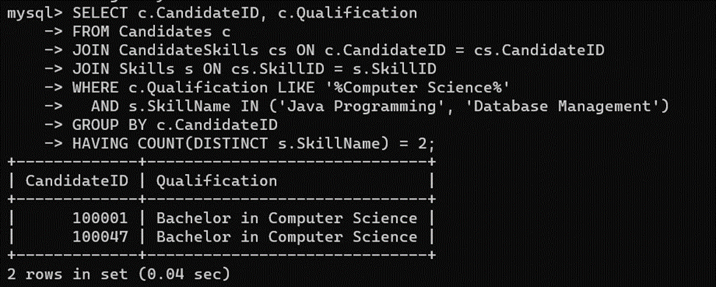
QUERY 2 OUTPUT

Slide 26
QUERY 3
Q3 : List all employers who have offered jobs with a salary higher than $75,000 but do not have employees who joined after 2018.
Query : SELECT e.EnterpriseName
FROM Employers e
JOIN Jobs j ON e.EmployerID = j.EmployerID
LEFT JOIN Employees emp ON e.EmployerID = emp.SupervisorID
WHERE j.Salary > 75000
AND NOT EXISTS (
SELECT 1 FROM Employees
WHERE SupervisorID = e.EmployerID AND DateJoined > '2018-01-01'
)
GROUP BY e.EnterpriseName;

Slide 27
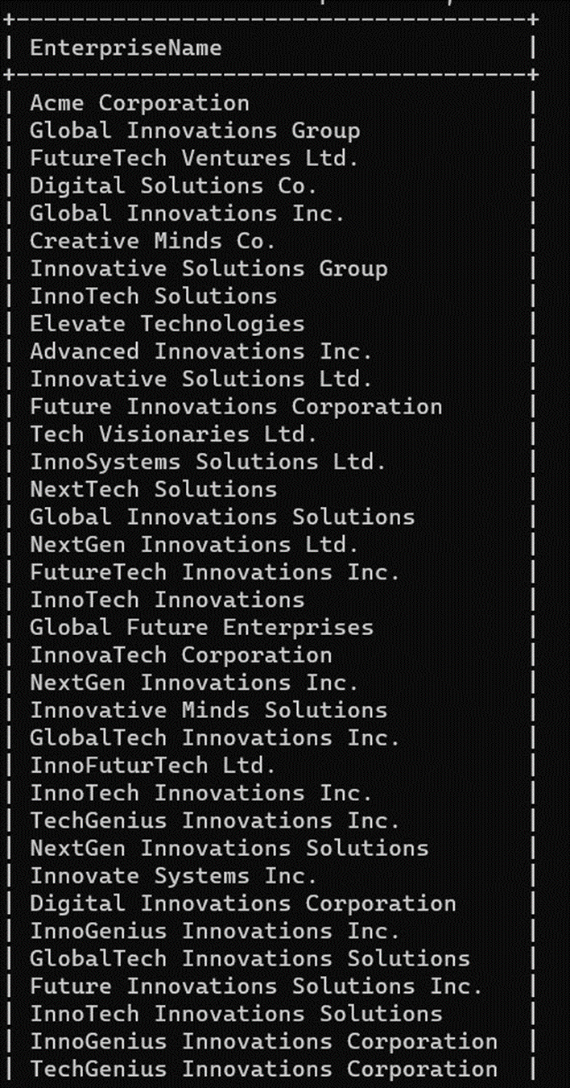
QUERY 3 OUTPUT

Slide 28
QUERY 4
Q4 : List the top 5 employers by the number of different job positions they have offered, along with the count of positions.
Query : SELECT e.EnterpriseName, COUNT(DISTINCT j.JobDescription) AS NumberOfPositions
FROM Employers e
JOIN Jobs j ON e.EmployerID = j.EmployerID
GROUP BY e.EnterpriseName
ORDER BY NumberOfPositions DESC
LIMIT 5;

Slide 29
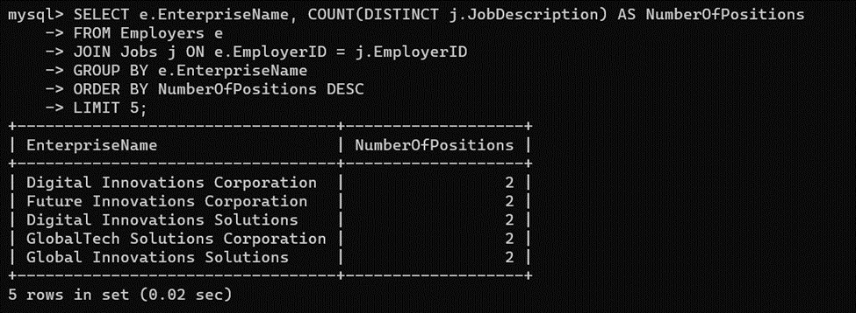
QUERY 4 OUTPUT

Slide 30
QUERY 5
Q5 : List the top 3 most common skills among candidates who have a qualification in 'Master in Business Administration'.
QUERY : SELECT s.SkillName, COUNT(*) AS Frequency
FROM Skills s
JOIN CandidateSkills cs ON s.SkillID = cs.SkillID
JOIN Candidates c ON cs.CandidateID = c.CandidateID
WHERE c.Qualification = 'Master in Business Administration'
GROUP BY s.SkillName
ORDER BY Frequency DESC
LIMIT 3;

Slide 31
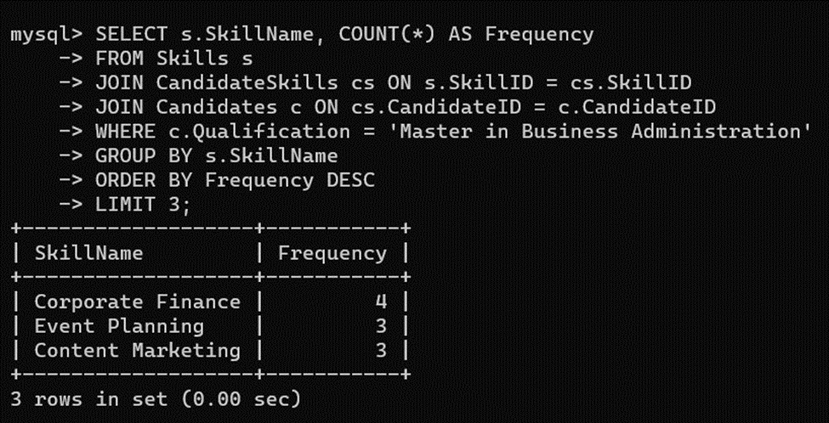
QUERY 5 OUTPUT

Slide 32
QUERY 6
Q6 : Which candidates have skills that match the requirements for the job 'Software Engineer'?
QUERY: SELECT DISTINCT c.CandidateID
FROM Candidates c
JOIN CandidateSkills cs ON c.CandidateID = cs.CandidateID
JOIN Skills s ON cs.SkillID = s.SkillID
WHERE s.SkillID IN (
SELECT SkillID
FROM CandidateSkills
WHERE CandidateID IN (
SELECT CandidateID
FROM Jobs
WHERE JobDescription = 'Software Engineer
)
);

Slide 33
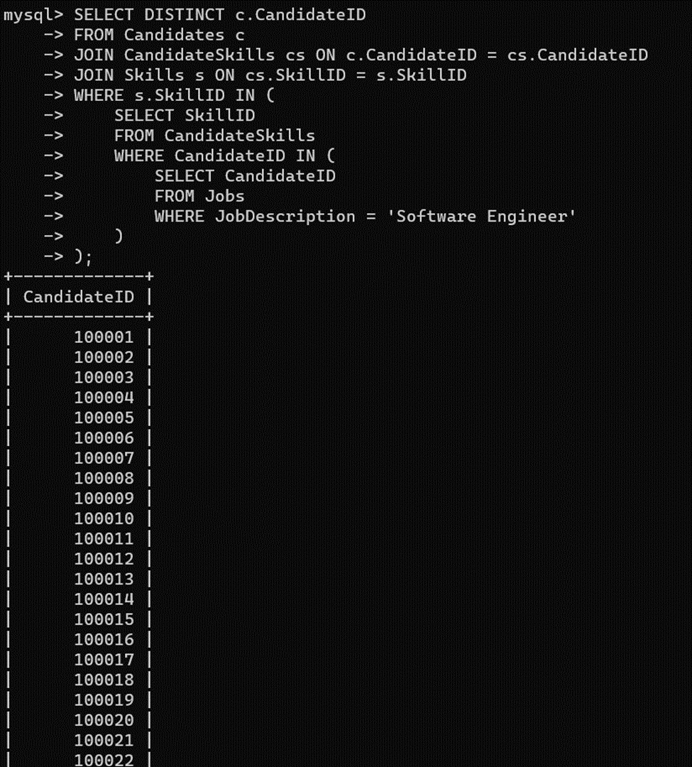
QUERY 6 OUTPUT

Slide 34
QUERY 7 OUTPUT
Q7 : How many candidates with a Master's degree have skills in 'Python Programming'?
QUERY : SELECT COUNT(DISTINCT c.CandidateID) AS CandidatesCount
FROM Candidates c
JOIN CandidateSkills cs ON c.CandidateID = cs.CandidateID
JOIN Skills s ON cs.SkillID = s.SkillID
WHERE c.Qualification LIKE '%Master%' AND s.SkillName = 'Python Programming';

Slide 35
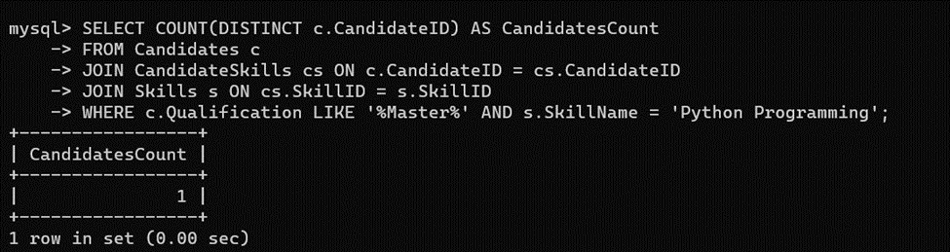
QUERY 7 OUTPUT

Slide 36
QUERY 8
Q8 : Identify candidates who have skills that no other candidate has.
QUERY :SELECT c.CandidateID, s.SkillName
FROM Candidates c
JOIN CandidateSkills cs ON c.CandidateID = cs.CandidateID
JOIN Skills s ON cs.SkillID = s.SkillID
WHERE s.SkillID NOT IN (
SELECT SkillID
FROM CandidateSkills
WHERE CandidateID != c.CandidateID
);

Slide 37
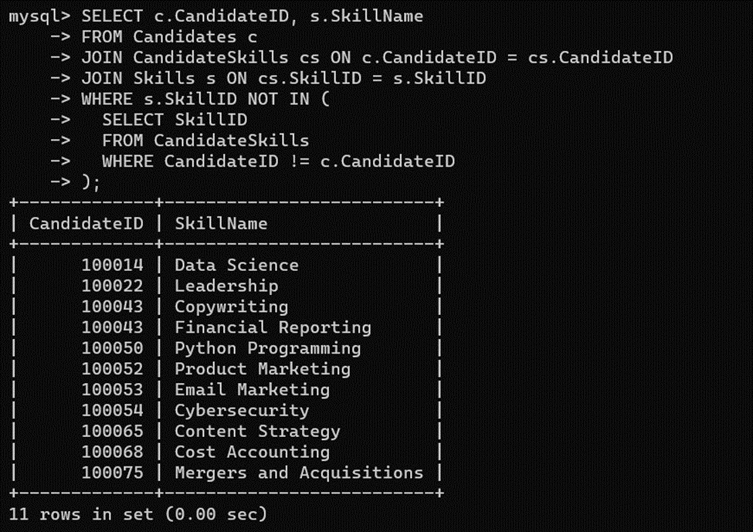
QUERY 8 OUTPUT

Slide 38
QUERY 9
Q9 : Determine the top 5 skills in demand for jobs that have no current candidates
QUERY : SELECT s.SkillName, COUNT(*) AS Demand
FROM Skills s
JOIN CandidateSkills cs ON s.SkillID = cs.SkillID
WHERE cs.CandidateID NOT IN (
SELECT c.CandidateID
FROM Candidates c
JOIN Jobs j ON c.CandidateID = j.EmployerID
)
GROUP BY s.SkillID
ORDER BY Demand DESC
LIMIT 5;

Slide 39
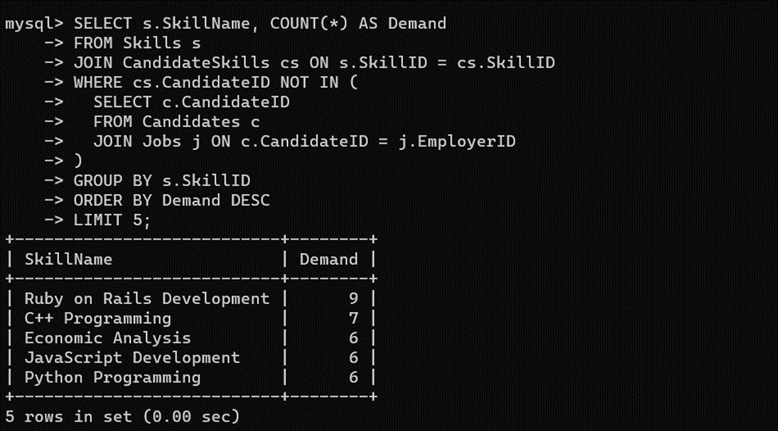
QUERY 9 OUTPUT

Slide 40
QUERY 10
Q10: Identify employers with no employees who have a skill in 'Data Analysis’
QUERY :SELECT e.EnterpriseName
FROM Employers e
WHERE NOT EXISTS (
SELECT 1 FROM Employees emp
JOIN Candidates c ON emp.EmployeeID = c.CandidateID
JOIN CandidateSkills cs ON c.CandidateID = cs.CandidateID
JOIN Skills s ON cs.SkillID = s.SkillID
WHERE s.SkillName = 'Data Analysis' AND e.EmployerID = emp.SupervisorID
);

Slide 41
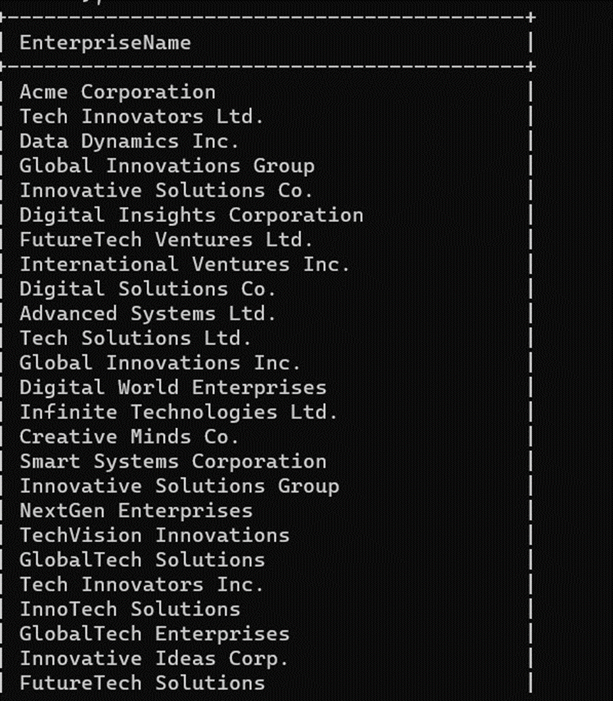
QUERY 10 OUTPUT

Slide 42
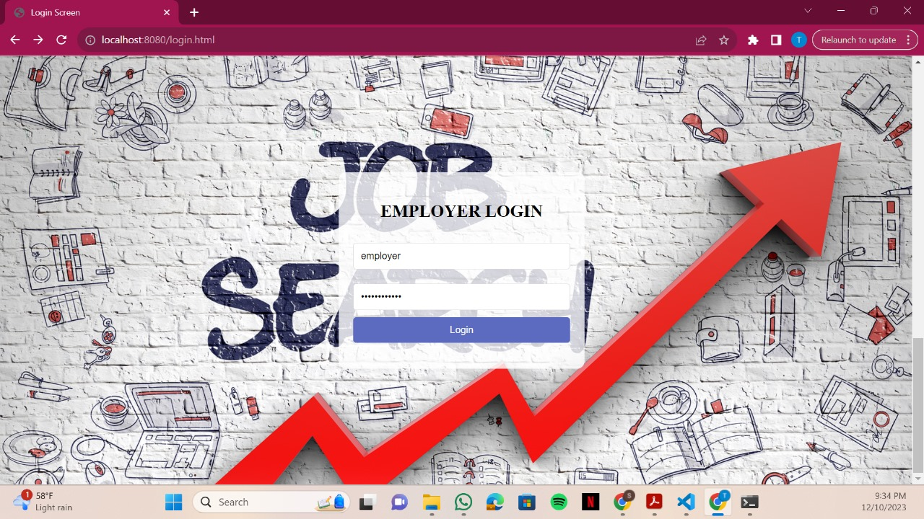
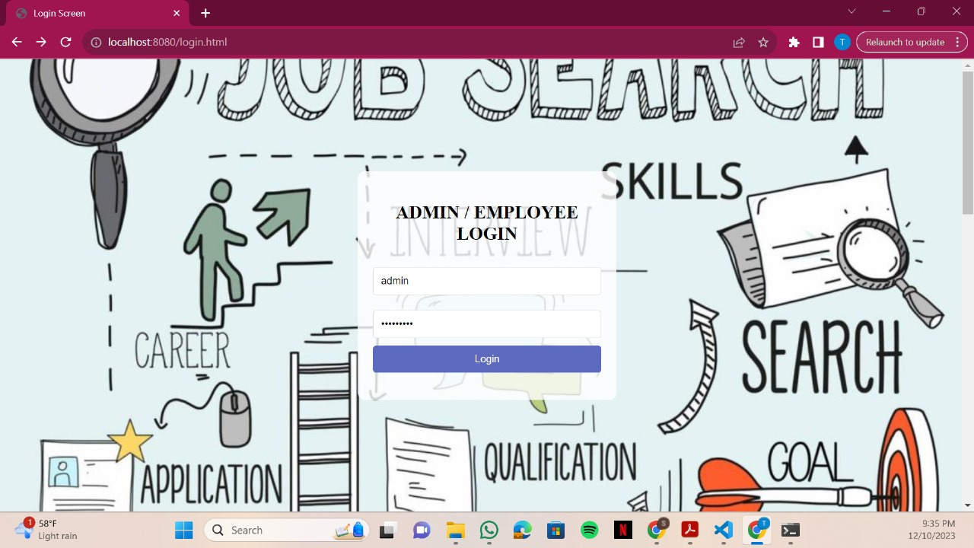
GLIMPSE OF FRONT-END DEVELOPMENT

Slide 43
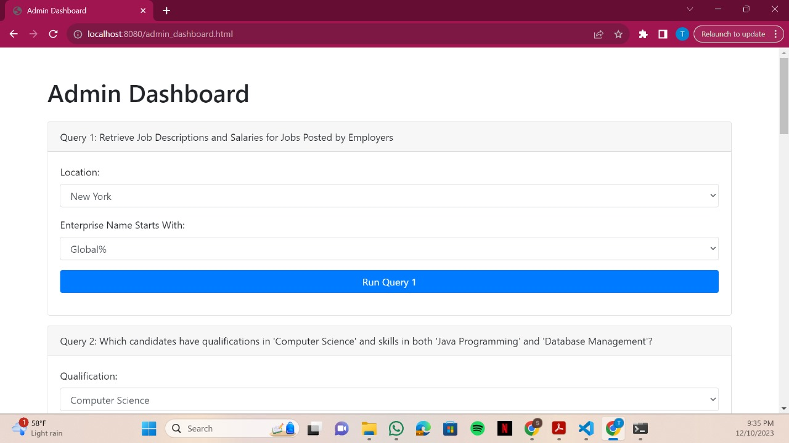
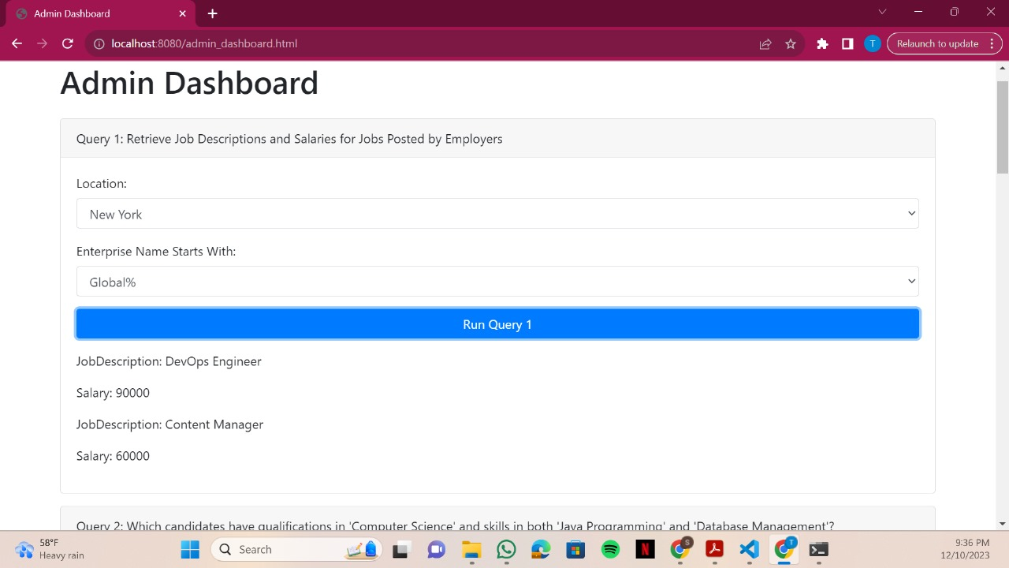
GLIMPSE OF FRONT-END DEVELOPMENT

Slide 44
FUTURESCOPE
Potentially, we can create a complete Job website, where we can upload resumes, and search for better outputs.
Probably we can fetch more real-time data using APIs rather than dummy data, to have better understanding.
We can fetch real time query, where we can edit and understand the necessary data analysis.

Slide 45
THANK YOU

